Slide 1
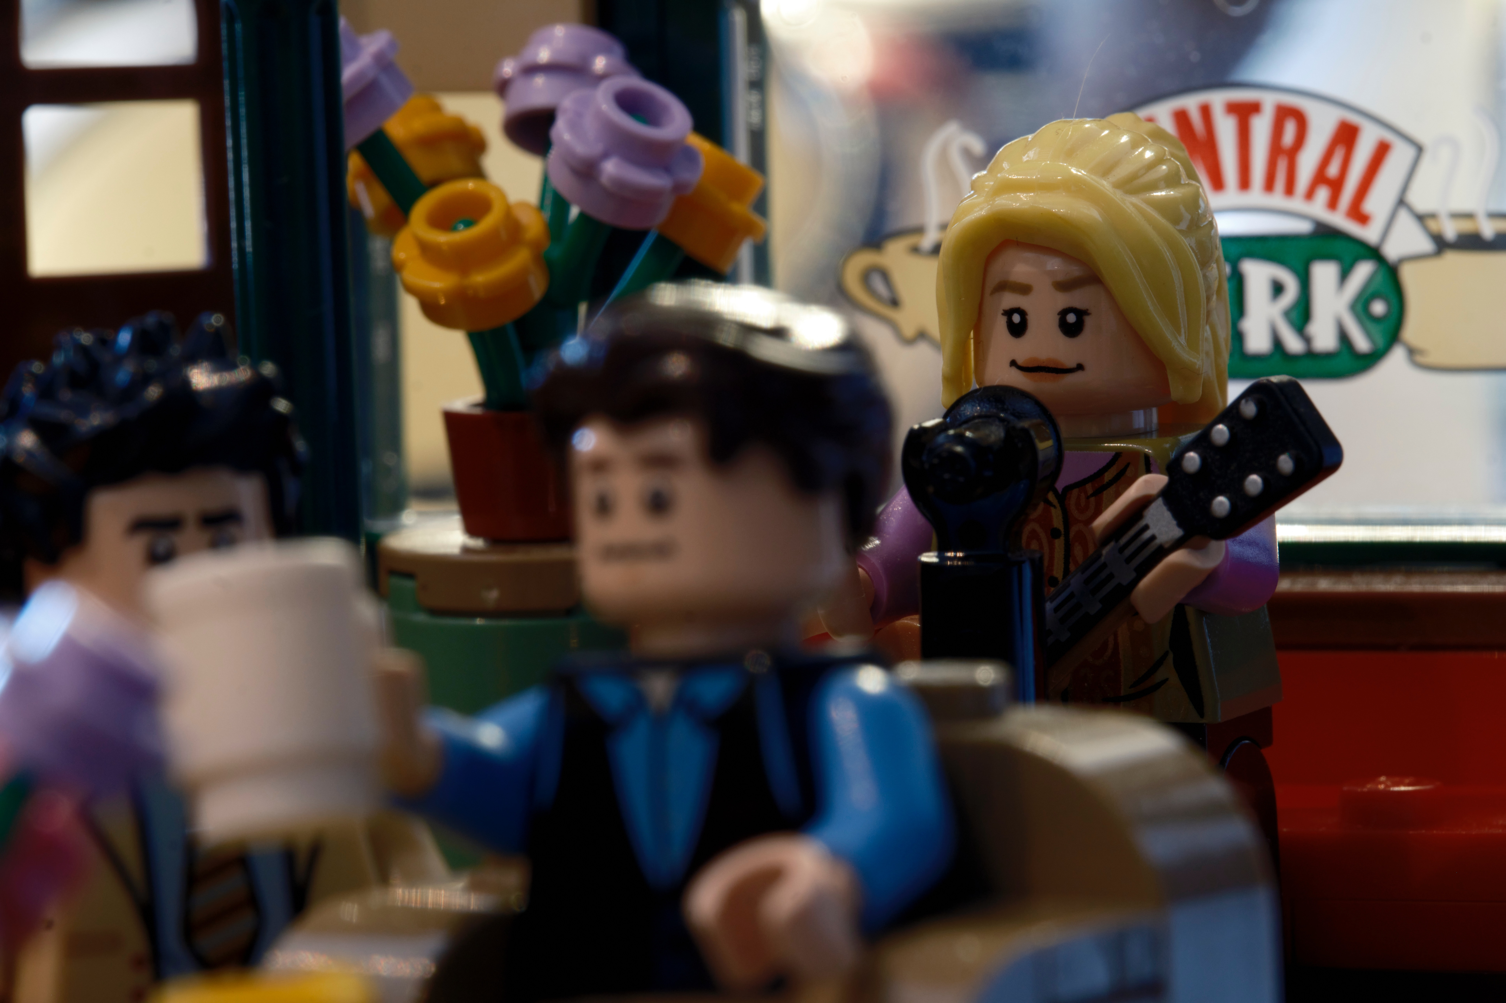
Notes:
Friends… Relationships…

Slide 2

Two truths and a lie
Notes:
Group dynamic

Slide 3

Notes:
Importance of Active Listening

Slide 4

User manual as a tool
Notes:
Importance of having meta conversations

Slide 5
Team culture?
Notes:
Adapting to Team Culture

